Slide 1
CS162 Operating Systems and Systems Programming Lecture 13 Scheduling 4: Deadlock (Finished)
March 2nd, 2023
Prof. John Kubiatowicz
http://cs162.eecs.Berkeley.edu

Slide 2

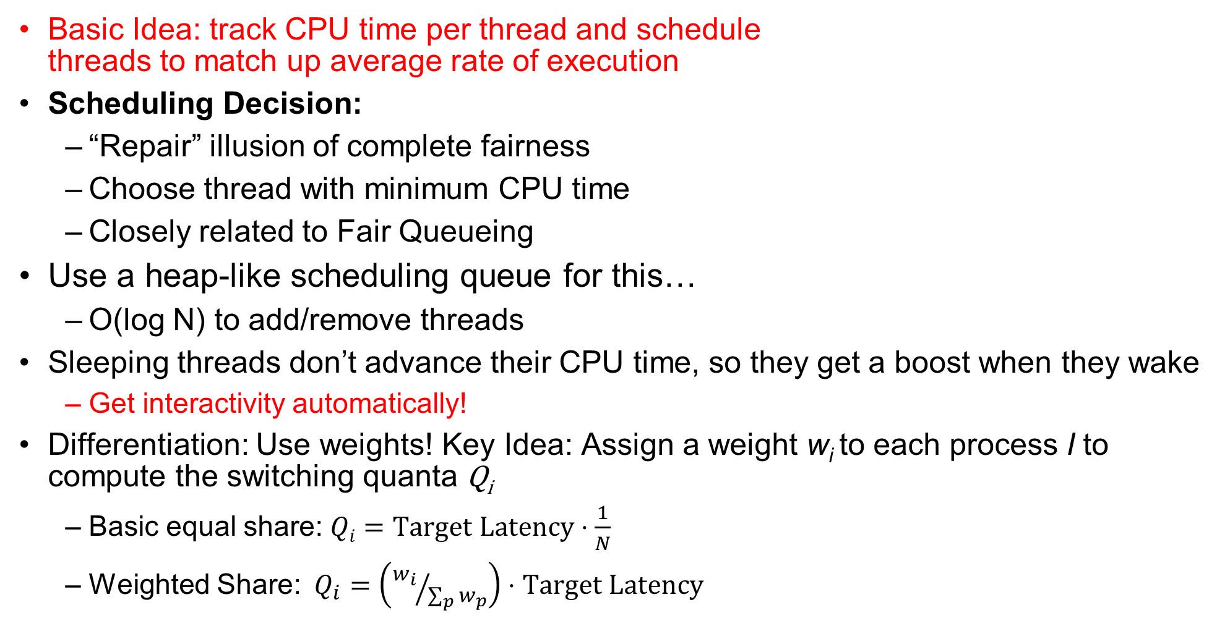
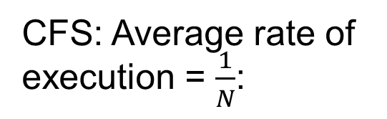
Recall: Linux Completely Fair Scheduler (CFS)
Basic Idea: track CPU time per thread and schedule threads to match up average rate of execution
Scheduling Decision:
“Repair” illusion of complete fairness
Choose thread with minimum CPU time
Closely related to Fair Queueing
Use a heap-like scheduling queue for this…
O(log N) to add/remove threads
Sleeping threads don’t advance their CPU time, so they get a boost when they wake
Get interactivity automatically!
Differentiation: Use weights! Key Idea: Assign a weight w_{i} to each process I to compute the switching quanta Q_{i}
Basic equal share: $Qi=Target Latency⋅\frac{1}{N}$
Weighted Share:$Q_{i}=\left({w_{i}}/{\sum_{p}{w_{p}}}\right)⋅Target Latency$
CFS: Average rate of execution = $\frac{1}{N}$:
T₁
$$\frac{1}{N}$$
T₃
Virtual CPU Time
T₂

Slide 3
Deadlock: A Deadly type of Starvation
Starvation: thread waits indefinitely
Example, low-priority thread waiting for resources constantly in use by high-priority threads
Deadlock: circular waiting for resources
Thread A owns Res 1 and is waiting for Res 2 Thread B owns Res 2 and is waiting for Res 1
Deadlock ⇒ Starvation but not vice versa
Starvation can end (but doesn’t have to)
Deadlock can’t end without external intervention
Thread
A
Wait
For
Owned
By
Res 1
Res 2
Owned
By
Wait
For
Thread
B
Notes:
Now let's look at some key problems we face when synchronizing or scheduling concurrent tasks.

Slide 4
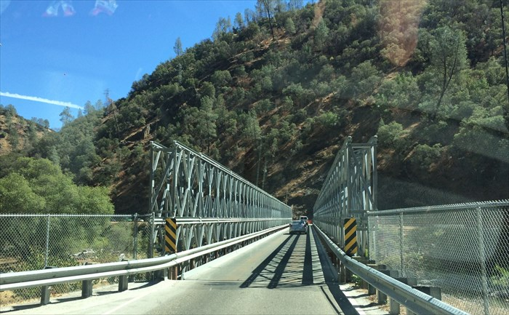
Example: Single-Lane Bridge Crossing
CA 140 to Yosemite National Park

Slide 5
Bridge Crossing Example
Each segment of road can be viewed as a resource
Car must own the segment under them
Must acquire segment that they are moving into
For bridge: must acquire both halves
Traffic only in one direction at a time
Deadlock: Shown above when two cars in opposite directions meet in middle
Each acquires one segment and needs next
Deadlock resolved if one car backs up (preempt resources and rollback)
Several cars may have to be backed up
Starvation (not Deadlock):
East-going traffic really fast ⇒ no one gets to go west
Owned
By
Wait
For
West Half
East Half
Honk!
Owned
By
Wait
For

Slide 6
Deadlock with Locks
Thread A:
x.Acquire();
y.Acquire();
…
y.Release();
x.Release();
Thread B:
y.Acquire();
x.Acquire();
…
x.Release();
y.Release();
Thread
A
Owned
By
Wait
For
Lock x
Lock y
Wait
For
Thread
B
Owned
By
This lock pattern exhibits non-deterministic deadlock
Sometimes it happens, sometimes it doesn’t!
This is really hard to debug!

Slide 7
Deadlock with Locks: “Unlucky” Case
Thread A:
x.Acquire();
y.Acquire(); <stalled>
<unreachable>
…
y.Release();
x.Release();
Thread B:
y.Acquire();
x.Acquire(); <stalled>
<unreachable>
…
x.Release();
y.Release();
Thread
A
Owned
By
Wait
For
Lock x
Lock y
Wait
For
Thread
B
Owned
By
Neither thread will get to run ⇒ Deadlock

Slide 8
Deadlock with Locks: “Lucky” Case
Thread A:
x.Acquire();
y.Acquire();
…
y.Release();
x.Release();
Thread B:
y.Acquire();
x.Acquire();
…
x.Release();
y.Release();
Sometimes, schedule won’t trigger deadlock!

Slide 9
Other Types of Deadlock
Threads often block waiting for resources
Locks
Terminals
Printers
CD drives
Memory
Threads often block waiting for other threads
Pipes
Sockets
You can deadlock on any of these!

Slide 10
Deadlock with Space
Thread A:
AllocateOrWait(1 MB)
AllocateOrWait(1 MB)
Free(1 MB)
Free(1 MB)
Thread B
AllocateOrWait(1 MB)
AllocateOrWait(1 MB)
Free(1 MB)
Free(1 MB)
If only 2 MB of space, we get same deadlock situation

Slide 11
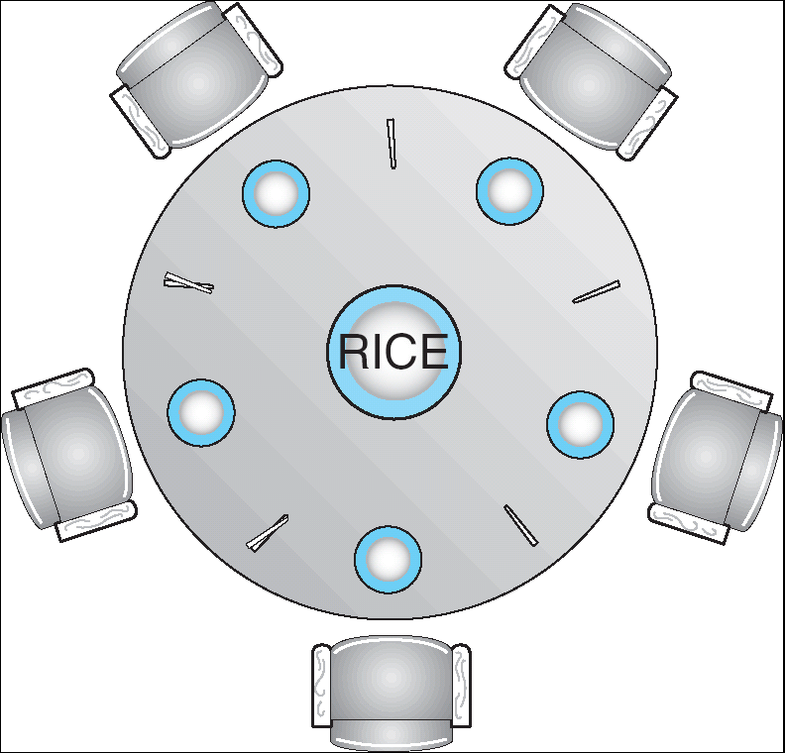
Dining Lawyers Problem
Five chopsticks/Five lawyers (really cheap restaurant)
Free-for all: Lawyer will grab any one they can
Need two chopsticks to eat
What if all grab at same time?
Deadlock!
How to fix deadlock?
Make one of them give up a chopstick (Hah!)
Eventually everyone will get chance to eat
How to prevent deadlock?
Never let lawyer take last chopstick if no hungry lawyer has two chopsticks afterwards
Can we formalize this requirement somehow?

Slide 12
Four requirements for occurrence of Deadlock
Mutual exclusion
Only one thread at a time can use a resource.
Hold and wait
Thread holding at least one resource is waiting to acquire additional resources held by other threads
No preemption
Resources are released only voluntarily by the thread holding the resource, after thread is finished with it
Circular wait
There exists a set {T₁, …, T_{n}} of waiting threads
T₁ is waiting for a resource that is held by T₂
T₂ is waiting for a resource that is held by T₃
…
T_{n} is waiting for a resource that is held by T₁

Slide 13
Administrivia
Welcome to Project 2
Please get started earlier than last time!
Midterm 2
Coming up in < 2 weeks! (3/15)
Everything up to the midterm is fair game (perhaps deemphasizing the lecture on the day before….)

Slide 14
Detecting Deadlock: Resource-Allocation Graph
System Model
A set of Threads T₁, T₂, . . ., T_{n}
Resource types R₁, R₂, . . ., R_{m}
CPU cycles, memory space, I/O devices
Each resource type R_{i} has W_{i} instances
Each thread utilizes a resource as follows:
Request() / Use() / Release()
Resource-Allocation Graph:
V is partitioned into two types:
T = {T₁, T₂, …, T_{n}}, the set threads in the system.
R = {R₁, R₂, …, R_{m}}, the set of resource types in system
request edge – directed edge T₁ → R_{j}
assignment edge – directed edge R_{j} → T_{i}
Symbols
T₁
T₂
R₁
R₂

Slide 15
Resource-Allocation Graph Examples
Model:
request edge – directed edge T₁ → R_{j}
assignment edge – directed edge R_{j} → T_{i}
R₁
R₂
R₁
R₂
R₁
T₂
T₁
T₂
T₃
T₁
T₂
T₃
T₁
T₃
R₃
T₄
R₄
R₃
R₂
R₄
Simple Resource
Allocation Graph
Allocation Graph With Deadlock
Allocation Graph With Cycle, but
No Deadlock

Slide 16
Deadlock Detection Algorithm
Let [X] represent an m-ary vector of non-negative integers (quantities of resources of each type):
[FreeResources]: Current free resources each type [Request_{X}]: Current requests from thread X [Alloc_{X}]: Current resources held by thread X
See if tasks can eventually terminate on their own
[Avail] = [FreeResources] Add all nodes to UNFINISHED do {
done = true Foreach node in UNFINISHED { if ([Request_{node}] <= [Avail]) { remove node from UNFINISHED [Avail] = [Avail] + [Alloc_{node}] done = false } } } until(done)
Nodes left in UNFINISHED ⇒ deadlocked
R₁
T₂
T₁
T₃
T₄
R₂

Slide 17
How should a system deal with deadlock?
Four different approaches:
Deadlock prevention: write your code in a way that it isn’t prone to deadlock
Deadlock recovery: let deadlock happen, and then figure out how to recover from it
Deadlock avoidance: dynamically delay resource requests so deadlock doesn’t happen
Deadlock denial: ignore the possibility of deadlock
Modern operating systems:
Make sure the system isn’t involved in any deadlock
Ignore deadlock in applications
“Ostrich Algorithm”

Slide 18
Techniques for Preventing Deadlock
Infinite resources
Include enough resources so that no one ever runs out of resources. Doesn’t have to be infinite, just large
Give illusion of infinite resources (e.g. virtual memory)
Examples:
Bay bridge with 12,000 lanes. Never wait!
Infinite disk space (not realistic yet?)
No Sharing of resources (totally independent threads)
Not very realistic
Don’t allow waiting
How the phone company avoids deadlock
Call Mom in Toledo, works way through phone network, but if blocked get busy signal.
Technique used in Ethernet/some multiprocessor nets
Everyone speaks at once. On collision, back off and retry
Inefficient, since have to keep retrying
Consider: driving to San Francisco; when hit traffic jam, suddenly you’re transported back home and told to retry!

Slide 19
(Virtually) Infinite Resources
Thread A
AllocateOrWait(1 MB)
AllocateOrWait(1 MB)
Free(1 MB)
Free(1 MB)
Thread B
AllocateOrWait(1 MB)
AllocateOrWait(1 MB)
Free(1 MB)
Free(1 MB)
With virtual memory we have “infinite” space so everything will just succeed, thus above example won’t deadlock
Of course, it isn’t actually infinite, but certainly larger than 2MB!

Slide 20
Techniques for Preventing Deadlock
Make all threads request everything they’ll need at the beginning.
Problem: Predicting future is hard, tend to over-estimate resources
Example:
If need 2 chopsticks, request both at same time
Don’t leave home until we know no one is using any intersection between here and where you want to go; only one car on the Bay Bridge at a time
Force all threads to request resources in a particular order preventing any cyclic use of resources
Thus, preventing deadlock
Example (x.Acquire(), y.Acquire(), z.Acquire(),…)
Make tasks request disk, then memory, then…
Keep from deadlock on freeways around SF by requiring everyone to go clockwise

Slide 21
Request Resources Atomically (1)
Rather than:
Thread A:
x.Acquire();
y.Acquire();
…
y.Release();
x.Release();
Thread B:
y.Acquire();
x.Acquire();
…
x.Release();
y.Release();
Consider instead:
Thread A:
Acquire_both(x, y);
…
y.Release();
x.Release();
Thread B:
Acquire_both(y, x);
…
x.Release();
y.Release();

Slide 22
Request Resources Atomically (2)
Or consider this:
Thread A
z.Acquire();
x.Acquire();
y.Acquire();
z.Release();
…
y.Release();
x.Release();
Thread B
z.Acquire();
y.Acquire();
x.Acquire();
z.Release();
…
x.Release();
y.Release();

Slide 23
Acquire Resources in Consistent Order
Rather than:
Thread A:
x.Acquire();
y.Acquire();
…
y.Release();
x.Release();
Thread B:
y.Acquire();
x.Acquire();
…
x.Release();
y.Release();
Consider instead:
Thread A:
x.Acquire();
y.Acquire();
…
y.Release();
x.Release();
Thread B:
x.Acquire();
y.Acquire();
…
x.Release();
y.Release();
Does it matter in which order the locks are released?

Slide 24
Train Example (Wormhole-Routed Network)
Circular dependency (Deadlock!)
Each train wants to turn right, but is blocked by other trains
Similar problem to multiprocessor networks
Wormhole-Routed Network: Messages trail through network like a “worm”
Fix? Imagine grid extends in all four directions
Force ordering of channels (tracks)
Protocol: Always go east-west first, then north-south
Called “dimension ordering” (X then Y)
Disallowed
By Rule

Slide 25
Techniques for Recovering from Deadlock
Terminate thread, force it to give up resources
In Bridge example, Godzilla picks up a car, hurls it into the river. Deadlock solved!
Hold dining lawyer in contempt and take away in handcuffs
But, not always possible – killing a thread holding a mutex leaves world inconsistent
Preempt resources without killing off thread
Take away resources from thread temporarily
Doesn’t always fit with semantics of computation
Roll back actions of deadlocked threads
Hit the rewind button on TiVo, pretend last few minutes never happened
For bridge example, make one car roll backwards (may require others behind him)
Common technique in databases (transactions)
Of course, if you restart in exactly the same way, may reenter deadlock once again
Many operating systems use other options

Slide 26
Another view of virtual memory: Pre-empting Resources
Thread A:
AllocateOrWait(1 MB)
AllocateOrWait(1 MB)
Free(1 MB)
Free(1 MB)
Thread B:
AllocateOrWait(1 MB)
AllocateOrWait(1 MB)
Free(1 MB)
Free(1 MB)
Before: With virtual memory we have “infinite” space so everything will just succeed, thus above example won’t deadlock
Of course, it isn’t actually infinite, but certainly larger than 2MB!
Alternative view: we are “pre-empting” memory when paging out to disk, and giving it back when paging back in
This works because thread can’t use memory when paged out

Slide 27
Techniques for Deadlock Avoidance
Idea: When a thread requests a resource, OS checks if it would result in deadlock
If not, it grants the resource right away
If so, it waits for other threads to release resources
THIS DOES NOT WORK!!!!
Example:
Thread A:
x.Acquire();
y.Acquire();
…
y.Release();
x.Release();
Thread B:
y.Acquire();
x.Acquire();
…
x.Release();
y.Release();
Blocks…
Wait?
But it’s already too late…

Slide 28
Deadlock Avoidance: Three States
Safe state
System can delay resource acquisition to prevent deadlock
Unsafe state
No deadlock yet…
But threads can request resources in a pattern that unavoidably leads to deadlock
Deadlocked state
There exists a deadlock in the system
Also considered “unsafe”
Deadlock avoidance: prevent system from reaching an unsafe state

Slide 29
Deadlock Avoidance
Idea: When a thread requests a resource, OS checks if it would result in deadlock an unsafe state
If not, it grants the resource right away
If so, it waits for other threads to release resources
Example:
Thread A:
x.Acquire();
y.Acquire();
…
y.Release();
x.Release();
Thread B:
y.Acquire();
x.Acquire();
…
x.Release();
y.Release();
Wait until Thread A releases mutex X

Slide 30
Banker’s Algorithm for Avoiding Deadlock
Toward right idea:
State maximum (max) resource needs in advance
Allow particular thread to proceed if:
(available resources - #requested) ≥ max remaining that might be needed by any thread
Banker’s algorithm (less conservative):
Allocate resources dynamically
Evaluate each request and grant if some ordering of threads is still deadlock free afterward
Technique: pretend each request is granted, then run deadlock detection algorithm, substituting: ([Max_{node}]-[Alloc_{node}] <= [Avail]) for ([Request_{node}] <= [Avail]) Grant request if result is deadlock free (conservative!)

Slide 31
Banker’s Algorithm for Avoiding Deadlock
[Avail] = [FreeResources] Add all nodes to UNFINISHED do {
done = true Foreach node in UNFINISHED { if ([Request_{node}] <= [Avail]) { remove node from UNFINISHED [Avail] = [Avail] + [Alloc_{node}] done = false } } } until(done)
Toward right idea:
State maximum (max) resource needs in advance
Allow particular thread to proceed if:
(available resources - #requested) ≥ max remaining that might be needed by any thread
Banker’s algorithm (less conservative):
Allocate resources dynamically
Evaluate each request and grant if some ordering of threads is still deadlock free afterward
Technique: pretend each request is granted, then run deadlock detection algorithm, substituting: ([Max_{node}]-[Alloc_{node}] <= [Avail]) for ([Request_{node}] <= [Avail]) Grant request if result is deadlock free (conservative!)

Slide 32
Banker’s Algorithm for Avoiding Deadlock
[Avail] = [FreeResources] Add all nodes to UNFINISHED do {
done = true Foreach node in UNFINISHED { if ([Max_{node}]-[Alloc_{node}] <= [Avail]) { remove node from UNFINISHED [Avail] = [Avail] + [Alloc_{node}] done = false } } } until(done)
Toward right idea:
State maximum (max) resource needs in advance
Allow particular thread to proceed if:
(available resources - #requested) ≥ max remaining that might be needed by any thread
Banker’s algorithm (less conservative):
Allocate resources dynamically
Evaluate each request and grant if some ordering of threads is still deadlock free afterward
Technique: pretend each request is granted, then run deadlock detection algorithm, substituting: ([Max_{node}]-[Alloc_{node}] <= [Avail]) for ([Request_{node}] <= [Avail]) Grant request if result is deadlock free (conservative!)

Slide 33
Banker’s Algorithm for Avoiding Deadlock
Toward right idea:
State maximum (max) resource needs in advance
Allow particular thread to proceed if:
(available resources - #requested) ≥ max remaining that might be needed by any thread
Banker’s algorithm (less conservative):
Allocate resources dynamically
Evaluate each request and grant if some ordering of threads is still deadlock free afterward
Technique: pretend each request is granted, then run deadlock detection algorithm, substituting: ([Max_{node}]-[Alloc_{node}] <= [Avail]) for ([Request_{node}] <= [Avail]) Grant request if result is deadlock free (conservative!)
Keeps system in a “SAFE” state: there exists a sequence {T₁, T₂, … T_{n}} with T₁ requesting all remaining resources, finishing, then T₂ requesting all remaining resources, etc..

Slide 34
Banker’s Algorithm Example
Banker’s algorithm with dining lawyers
“Safe” (won’t cause deadlock) if when try to grab chopstick either:
Not last chopstick
Is last chopstick but someone will have two afterwards
What if k-handed lawyers? Don’t allow if:
It’s the last one, no one would have k
It’s 2nd to last, and no one would have k-1
It’s 3rd to last, and no one would have k-2
…

Slide 35
Deadlock Summary
Four conditions for deadlocks
Mutual exclusion
Hold and wait
No preemption
Circular wait
Techniques for addressing Deadlock
Deadlock prevention:
write your code in a way that it isn’t prone to deadlock
Deadlock recovery:
let deadlock happen, and then figure out how to recover from it
Deadlock avoidance:
dynamically delay resource requests so deadlock doesn’t happen
Banker’s Algorithm provides on algorithmic way to do this
Deadlock denial:
ignore the possibility of deadlock

